Slide 1
Programming and Algorithm
Lab Class 1: Basic Programming

Slide 2
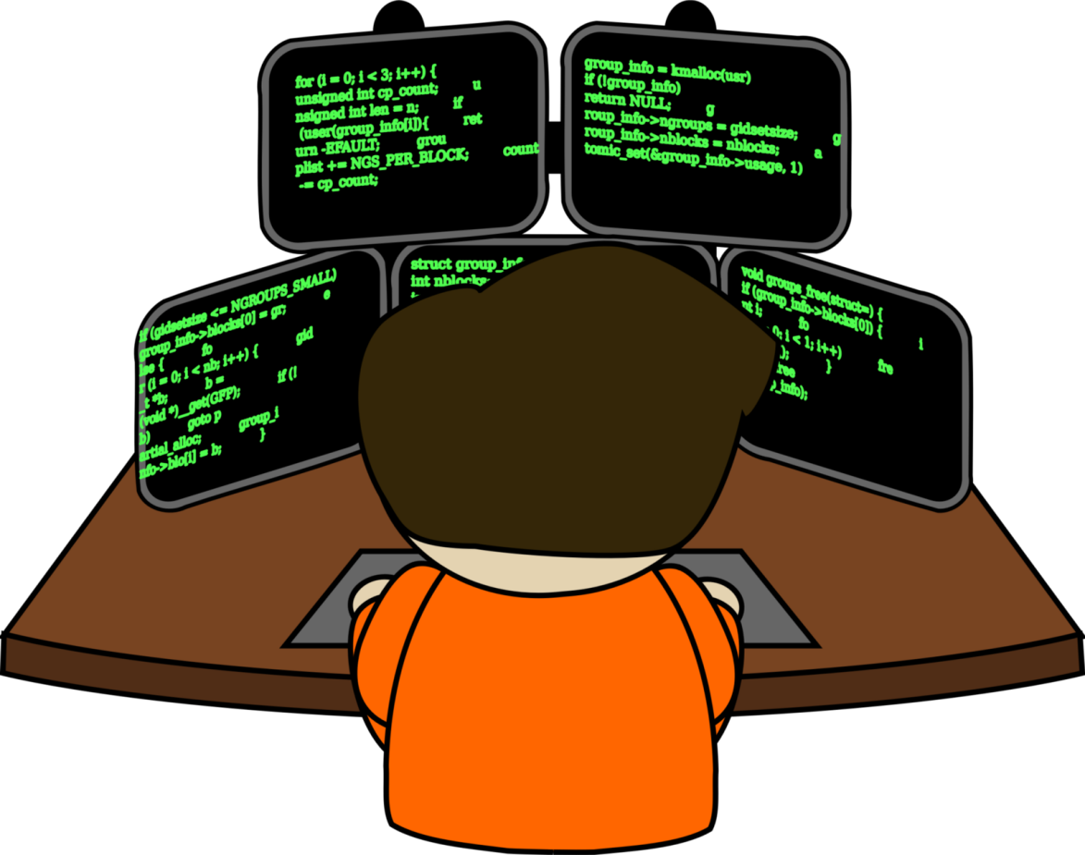
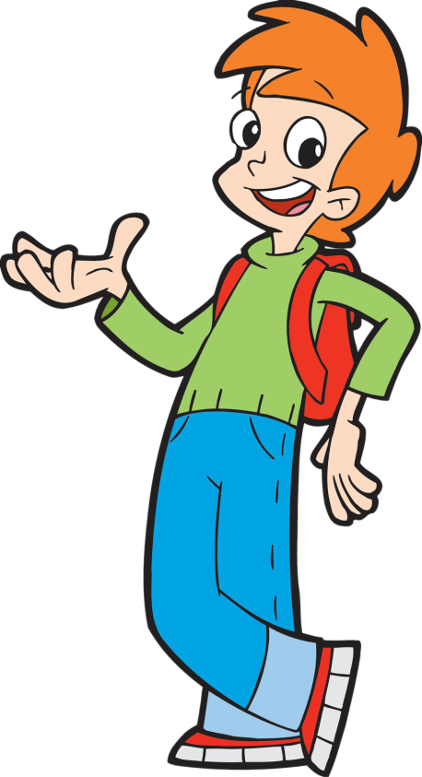
Welcome to Basic Programming Class

Slide 3

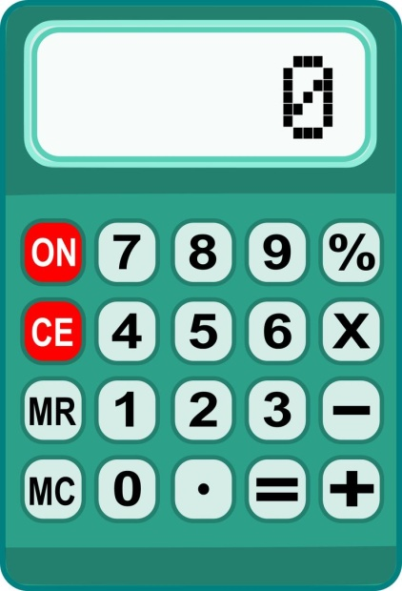
What is Programming ?
Programming means giving instruction to a computer or computing devices.
These instructions are known as Programming code.

Slide 4

Who is Programmer?
Hi! I am a programmer
A person who writes code
is known as a programmer.

Slide 5
What is Programming Language?
A programming language is a vocabulary and set of grammatical rules for giving commands and instruction to a computer

Slide 6
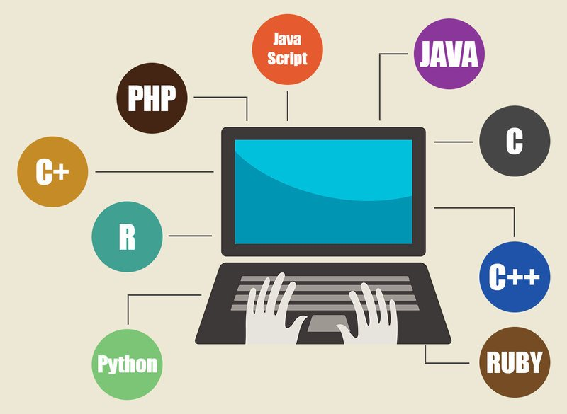
Programming Languages

Slide 7
We Can Make
Websites
Mobile Apps
Desktop Apps
Robot

Slide 8
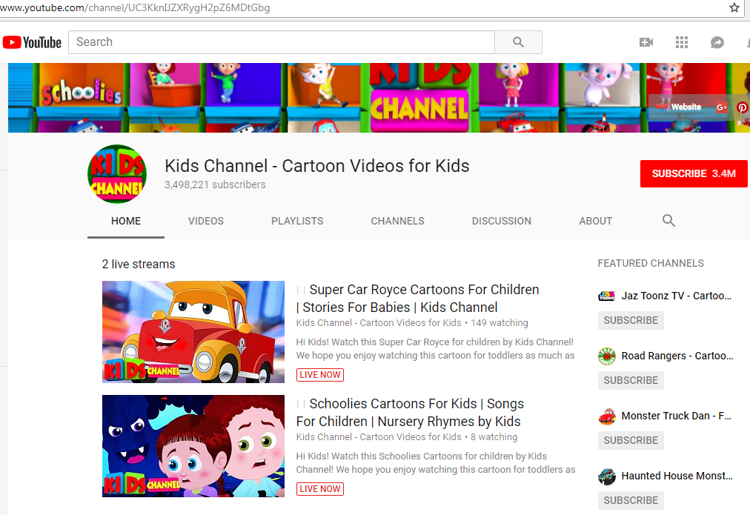
Websites

Slide 9
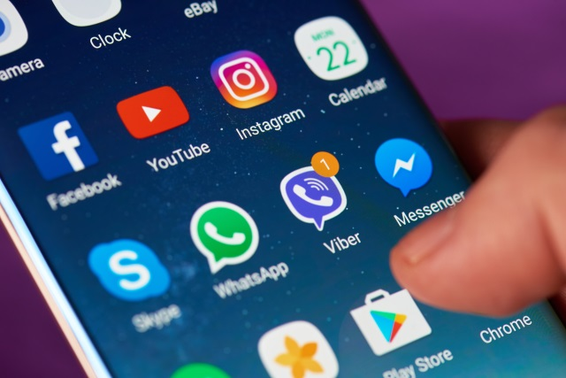
Mobile Applications

Slide 10
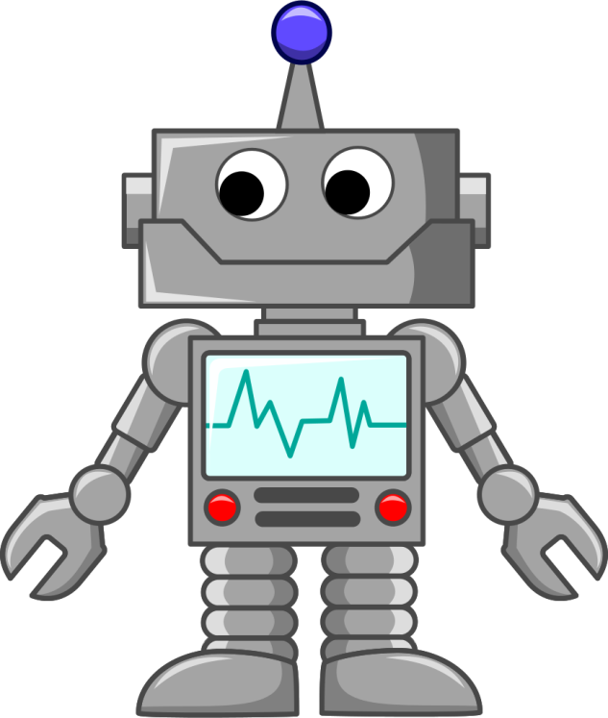
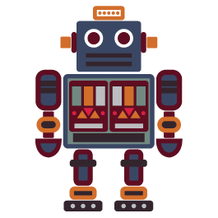
Robot

Slide 11
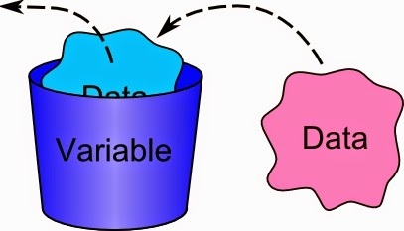
Variable
Product B
Variables are containers for storing data values.
var x = 5;
var y = 6; var z = x + y;
x, y, z is variable
5
X
5

Slide 12

Variable: Data Type
var marks = 80;
Integer
var grade = 4.50;
Decimal
var name = “Zyan”
String

Slide 13
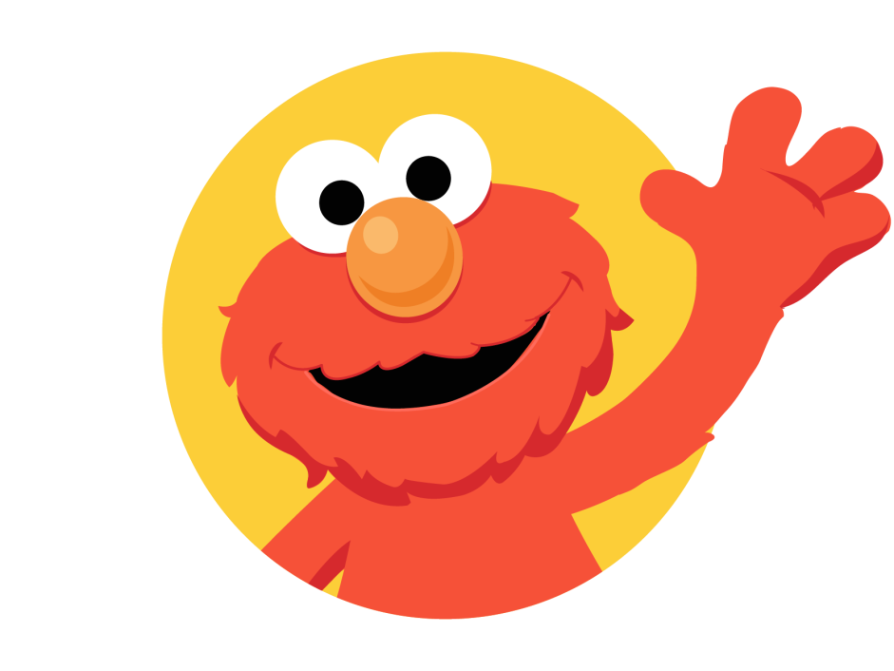
Thank You!

